Slide 1
Before we start
Extra office hrs next week Thurs 9-11
Week of Thanksgiving?
Presentations and Proposals
5 minute presentations
5 minute Q&A
~ 15 page proposal (double-spaced)
intro
motivation
question
identification strategy and (proposed) data

Slide 2

Causal methods in…
*complete with maps and fake data!
**and yes, this is proof that I am a total geek
Notes:
With Special attention to program evaluation
Want to convince you that it matters

Slide 3
Location matters
Context matters
What the neighbours do matters
Map of housing prices in a neighbourhood
Notes:
Location: land heterogeneity
Ag
Environment
Internet startup in San Francisco
Position in a social network
Context: social norms and women’s empowerment program
What the neighbours do, matters

Slide 4
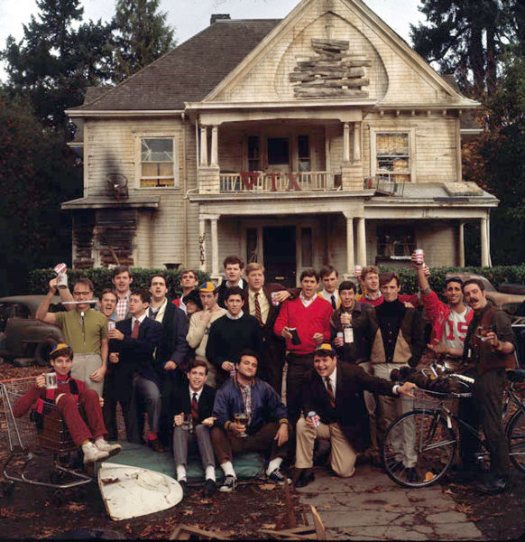

Slide 5
Plan for the day
1. A few concepts
2. Treatment in space
2.1 Overview of issues
2.2 Randomized Control Trial in Space
2.2 Regression Discontinuity Design
2.3 Matching
2.4 Modifiable Areal Unit Problem
Examples with real data!
3.1 spatial processes and bias
3.2 leakage/spillovers (mechanistic vs behavioural)
3.3 heterogeneity

Slide 6


Slide 7
Positive Correlation
Positive spatial spillovers
Information
Clustering

Slide 8
Negative correlation
“checkerboard” pattern
What I do discourages others from doing the same
(resource) competition
Dependent on scale
Notes:
Note issues in terms of unit of analysis

Slide 9
Does competition always lead to negative spatial correlation?
Consider the location of ice-cream stands along a beach…

Slide 11
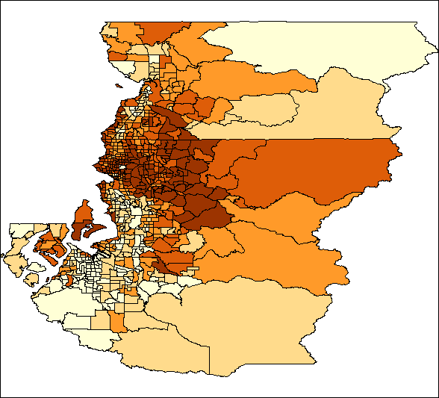
Seattle Area Housing prices

Slide 12
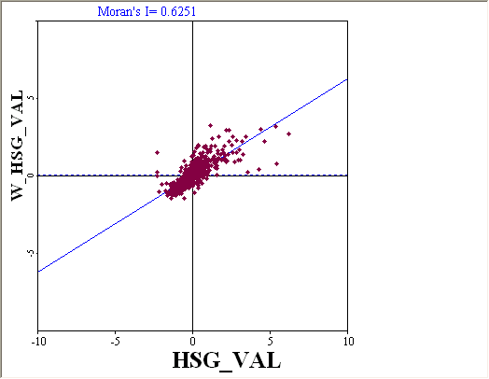
Moran’s I on Housing Values

Slide 13
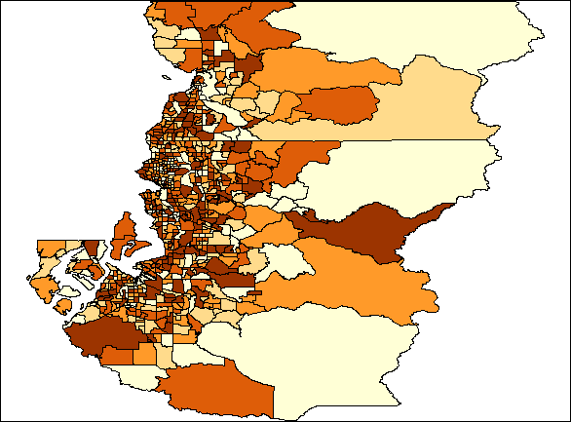
Very different geographic distribution
(Male population in the Seattle area)

Slide 14
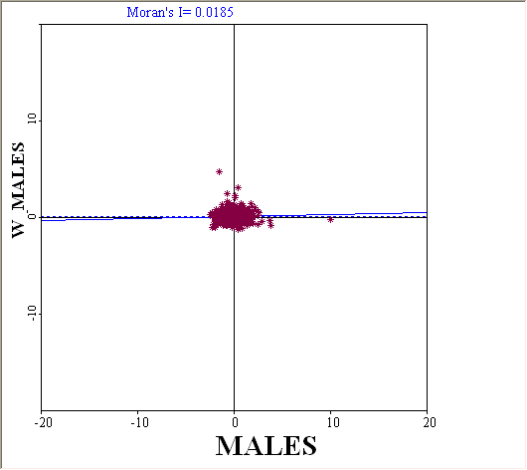
Moran’s I on Male pop

Slide 15

Spatial error, spatial lag and spatial heterogeneity
I rake my leaves when my neighbour does
Error
Lag
Might be omitted variable…
Everyone in this area is more sensitive to the timing of leaves falling because they have bigger lawns (heterogeneity)
Notes:
Lag: guilt
Error: tree dumps leaves at the same time

Slide 16
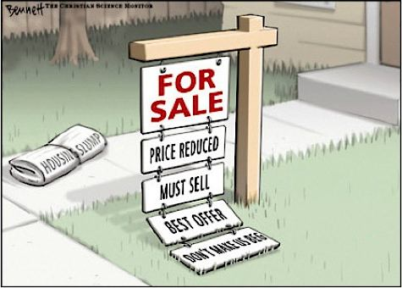
e.g. 2
Marginal value of a pool is higher in Austin than Seattle (Spatial Heterogeneity)
Price of houses affected by one house being sold at foreclosure for a loss.
Price of houses in one block affected by (unobserved) weekly block parties.

Slide 17
Spatial error
Outcome depends on some spatially-correlated unobservable
y = + Xβ + ε
Where ε = λW ε + ν, and ν~n(0,σ)

Slide 18
Spatial Effects: Spatial Correlation in error term
y = + Xβ + ε
where ε = λW ε + ν,
and ν~n(0,σ)
Cash crop production
Distance from market
Notes:
Outcome depends on some spatially-correlated unobservable
y = + Xβ + ε
Where ε = λW ε + ν, and ν~n(0,σ)

Slide 19
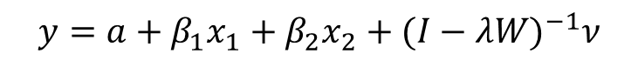
Spatial correlation: Fake Data 1
$$y=a+β_{1}x_{1}+β_{2}x_{2}+{(I−λW)}^{−1}ν$$
 | actual | OLS | OLS std. dev. | SE estimate | SE std. dev
Intercept | 1 | 0.84 | 3.85 | 0.90 | 3.77
b1 | 4 | 4.02 | 0.22 | 4.01 | 0.11
b2 | -10 | -10.01 | 0.04 | -10.00 | 0.02
lambda | 0.9
Notes:
N=100

Slide 20
Spatial correlation: Fake Data 1
$$y=a+β_{1}x_{1}+β_{2}x_{2}+{(I−λW)}^{−1}ν$$
 | actual | OLS | OLS std. dev. | SE estimate | SE std. dev
Intercept | 1 | 0.84 | 3.85 | 0.90 | 3.77
b1 | 4 | 4.02 | 0.22 | 4.01 | 0.11
b2 | -10 | -10.01 | 0.04 | -10.00 | 0.02
lambda | 0.9

Slide 21
Spatial Lag Model: my action depends on that of my neighbours
y = (I-ρW)⁻¹ (Xβ + ε)
Model will be misspecified without considering neighbours.
But… need to control for simultaneity of yi and yj.
Notes:
ML or GMM (spatial 2sls)
e.g. trying to determine when to pick up leaves
Regress number of people raking on days of the week (y_{i} = x+e)
Find everyone raked Friday evening
But really everyone raked when everyone else rakes, so next year everyone rakes on Sundays. (y_{i} = y_{j} +e)

Slide 22

Spatial lag: fake data 1
$$y=ρWy+a+ β_{1}x_{1}+β_{2}x_{2}+ν$$
Marginal effects
$$\frac{dy}{dx_{1}}={(I−ρW)}^{−1} β_{1}$$
 | actual beta | marginal effect
Intercept | 1 | 10
b1 | 4 | 40
b2 | -10 | -100
rho | 0.9
 | mean | std. dev
Y | 223.72 | 38.51
x1 | 5.02 | 0.09
x2 | -0.13 | 0.39
e | 0.01 | 0.27

Slide 23
Spatial lag: fake data 2
 | actual | Marginal effect | OLS estimate | std. dev. | SE estimate | std. dev
Intercept | 1 | 10 | 184.11 | 43.48 | 0.94 | 0.73
b1 | 4 | 40 | 5.32 | 1.93 | 4.01 | 0.13
b2 | -10 | -100 | -13.18 | 0.50 | -10.00 | 0.02
Notes:
Andres – can you update?

Slide 24

2.1 Inference in space
SUTVA (biased treatment estimates)
Inaccurate standard errors (inaccurate inference)

Slide 25
2.2. Randomized Control Trials in Space
Notes:
OK, we’d expect to see spatial ‘issues’ with spatial data, but RCTs should solve those, right??
**Find RCT references that might be affected

Slide 26
Notes:
OLS
OLS w. clustered errors
OLS taking spatial relations into account
*q for Andres – why is the distribution so wide? So the estimates listed here are not using the boostraped Se’s?

Slide 27
ρ = 0.2

Slide 28
ρ = 0.5

Slide 29
ρ = 0.9

Slide 30
is clustering enough?
Imposes an arbitrary spatial structure
Is it better to estimate some of that spatial structure?
Doesn’t address other issues with spatial lag

Slide 31
Notes:
e.g. Randomize within districts (stratified sampling of villages)

Slide 32
Application (Bramouille … Kandpal and Baylis 2013, 2014; Kandpal, Baylis and Arends-Kuenning 2013; Ham and …; Songermsawas et al 2014)
village 1
Notes:
Think about what this means for estimating treatment: Who is the appropriate control? Spillover effects of CCTs
Find substantial spillover effects of a women’s empowerment program in India.
When do you change social norms
Note – who gets the program matters

Slide 33

e.g. 2: Social network effects in India
village 1: Treatment
village 2: Control
Notes:
Think about what this means for estimating treatment: Who is the appropriate control? Spillover effects of CCTs
Find substantial spillover effects of a women’s empowerment program in India.
When do you change social norms
Note – who gets the program matters
Note – even comparing treated woman in first village to her counterpart in second village, will underestimate the effect of the program b/c ignoring spillovers

Slide 34
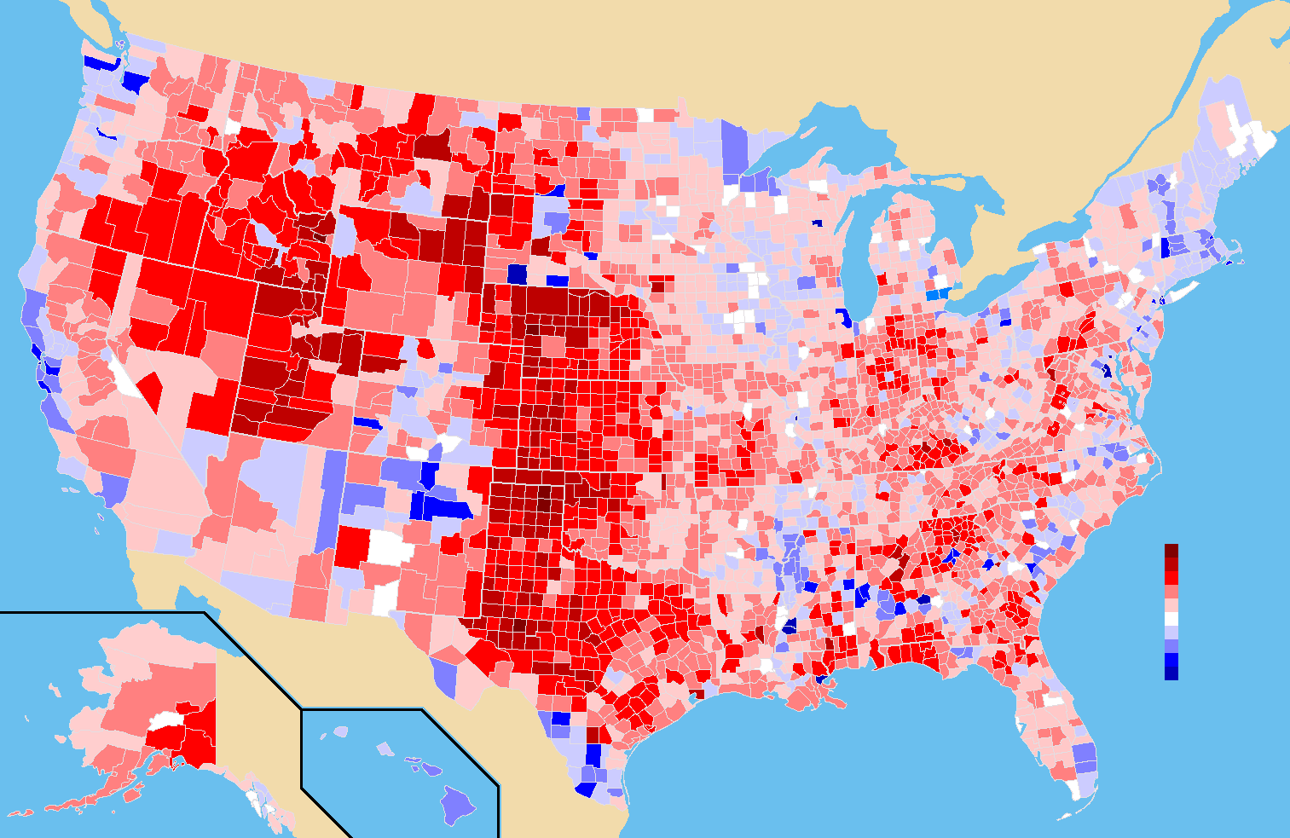
2.2 regression discontinuity
Notes:
Imagine one wanted to look at the effect of having a republican-controlled state legislature on federal election outcomes, so used a 50% vote cut-off as the discontinuity at the boundary. But media markets are diffuse – probably a spatial error if not a lag

Slide 35
outcome
measure
Notes:
Find references
*Andres – can you code this up?

Slide 36

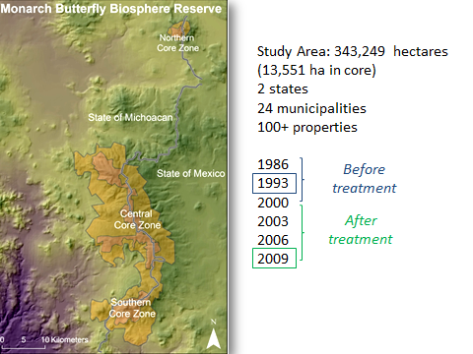
2.3 Matching: e.g. PES in Mexico
(Honey-Roses, Baylis and Ramirez 2011; Baylis, Honey-Roses and Ramirez 2014)

Slide 37
The problem: want to estimate the effect of a policy that targets a specific area
Policy (Treatment)
Issue: what would have happened without the policy?
Choice of location for policy is not random.
It is (somehow) different than other locations not chosen.
The rocks and ice problem

Slide 38
Traditional approach: before vs after
T
C
Ignores overall trends

Slide 39
Traditional approach: Inside vs outside
T
C
Ignores differences in probability of degradation

Slide 40
Matching
Or, more likely…
Find a set of ‘matched’ control (untreated) parcels with similar characteristics to the treated parcels
If we do a good job finding control parcels that look like the treated parcels, we can replicate what would have happened without protection*
*Assumes unobservable characteristics are distributed in the same way as observables: i.e. Matching over observables => matching over unobservables

Slide 41
Model Refinements
 | Model 1 | Model 2 | Model 3
Method | Matching | Spatial Matching | Spatial Matching
Treatment | T | T | T
Control | C | C | C - Boundary with T
Obs. per year (controls used) | 4203 (771) | 4203 (739) | 4009 (738)
Average ‘distance’ | 2.15 | 5.67 | 6.83

Slide 42
Abadie and Imbens (2006) Matching estimator
Matches over covariates weighted by inverse variance.
Bias-corrected to adjust estimates for differences in covariates.
Match over
physical characteristics (elevation, slope, aspect, distance to road, size, tree species, density of forest cover),
governance (property type, state, prior regulation).
Match each ‘treated’ plot to 5 controls.

Slide 43
Avoided forest loss (1993 vs 2009): Matching

Slide 44
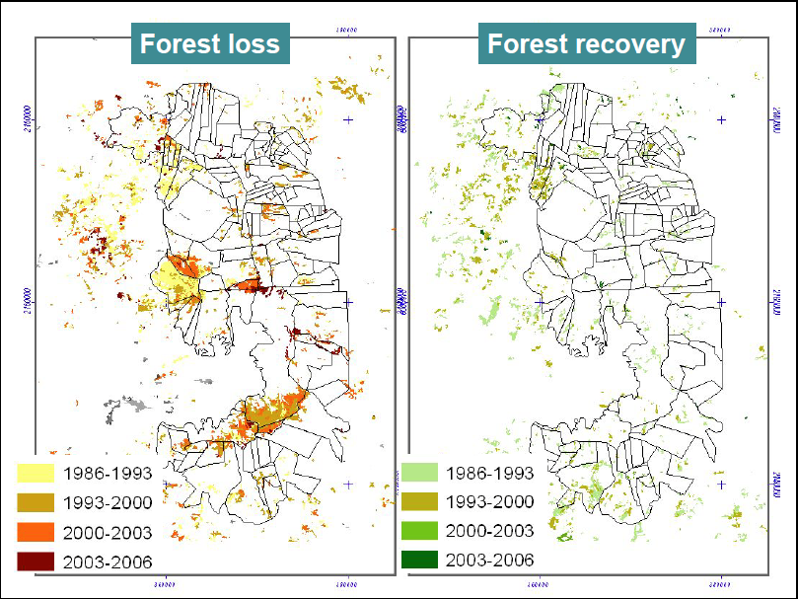

Slide 45
Evidence of Spatial Spillover

Slide 46
Significant spatial correlation
Rate of deforestation
 | Moran's I | p-stat
1993 | 0.050 | 0.00
2000 | 0.137 | 0.00
2003 | 0.141 | 0.00
2006 | 0.099 | 0.00
2009 | 0.105 | 0.00
Moran’s I: corr coefficient between outcome in observation I and its neighbours

Slide 47
Spatial Matching
Premise: What happens in one parcel is not independent of what happens in neighbouring parcels
 |  |  |  |  |  | T
PES
Dense forest
Disturbed forest
Agriculture

Slide 48
Spatial Matching
Premise: What happens in one parcel is not independent of what happens in neighbouring parcels
 |  | C |  |  |  | T
PES
Dense forest
Disturbed forest
Agriculture
Match over own and neighbouring parcel characteristics

Slide 49
Avoided forest loss (1993 vs 2009): Spatial matching

Slide 50
C
T

Slide 51
Avoided forest loss (1993 vs 2009): without controls bordering treatment

Slide 52
Punchline
spatial spillovers matter

Slide 53

2.4 Modifiable Areal Unit Problem (MAUP) (Goldilocks and the Grid: Avelino, Baylis, Honey-Roses 2014)

Slide 54
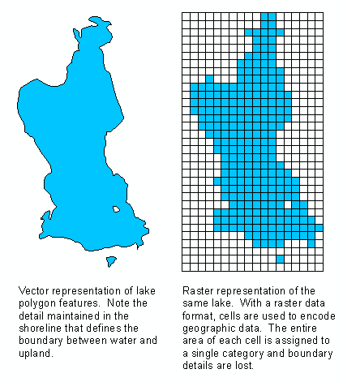
1. Introduction Conservation Policy Evaluation and Data
The availability of land use / forest cover data is essential for conservation policy evaluation
remote sensing images
↑ quality and resolution (< 1m)
+
Scale compatibility
Economic/social data
Notes:
Now down to 1m resolution – can literally lose

Slide 55
1. Introduction Conservation Policy Evaluation and Data
The availability of land use / forest cover data is essential for conservation policy evaluation
remote sensing images
↑ quality and resolution (< 1m)
+
Scale compatibility
Economic/social data
At which scale is the true process taking place?
What are the consequences of choosing the wrong one?

Slide 56
Authors | Zoning | Cell size (ha) | Study Area (km²) | # Obs (cross-section) | Imagery & Resolution | Method | Sample
Alix-Garcia et al. 2012 | Grid | 6 | 335,000 | 633 | MODIS (250 m) | Matching | Yes
Andam et al. 2008 | Grid | 3 | 30,357 | 15,383 | Landsat TM (30 m) | Matching | Yes
Baylis et al. 2015 | Grid | 4 | 3,427 | 85,693 | Landsat TM (30 m) | Matching | No
Blackman 2015 | Grid | 6.25 | 21,000 | 397,376 | Landsat (30 m) | Matching | Yes
Börner et al 2015 | Grid | 40,000 | 4,100,000 | 11,181 | Landsat & MODIS | Matching | No
Bruggeman et al. 2015 | Grid | 0.09 | 24,000 | 3,000 | Landsat ETM (30 m) | Matching | Yes
Busch & Grantham 2013 | Grid | 900 | 1,759,194 | 195,466 | MODIS (250 m) | OSIRIS | No
Clements & Milner-Gulland 2014 | Grid | 100 | 3,304 | 3,304 | Landsat TM (30 m) Aster (30 m) | Matching | Yes
Costedoat et al 2015 | Grid | 10 | 1,468 | 2,524 | SPOT 5 (10 m) | Matching | No
Ferraro & Hanauer 2014 | Census | 295 (mean) | 50,660 | 17,239 | Landsat TM (30 m) | Matching | No
Gaveau et al 2009 | Grid | 2 | 440,000 | 1,256 (T) | Landsat TM (30 m) | PSM | Yes
Honey-Rosés et al 2011 | Patches | 20.8 (mean) | 3,432 | 4,263 (T+C) 425 (T) | Landsat TM (30 m) | Matching + DiD | No
Pfaff 1999 | County | 33,000 (mean) | 5,000,000 | 480 | Landsat TM (reclassified to 1 km²) | Regression | No
Pfaff et al. 2015 | Grid | 0.81 | 156,522 | 20,072 (T+C) 7,775 (T) | Landsat TM (30 m) | Matching | Yes
Sanchez-Azofeifa et al 2007 | Grid | 2,500 | 50,100 | 2,021 | Landsat TM (30 m) | OLS | No
Shah & Baylis 2015 | Grid | 900 | 1,565,604 | 3,957(T) 170,899(C) | MODIS (250 m) | Matching | No
Sills et al 2015 | Municipality | NA | 15,000 | NA | INPE; Brazilian National Space Agency | Synthetic Control | No
Sims 2010 | Locality | 8,200 (mean) | 147,620 | 4,113 | Landsat (30 m & 60 m) | OLS & IV | No
Sims & Alix-Garcia 2015 | Village Thiessen polygons | 215 (mean) | 335,000 | 59,536 | Landsat TM (30 m) | Matching | Yes

Slide 57
Authors | Zoning | Cell size (ha) | Study Area (km²) | # Obs (cross-section) | Imagery & Resolution | Method | Sample
Alix-Garcia et al. 2012 | Grid | 6 | 335,000 | 633 | MODIS (250 m) | Matching | Yes
Andam et al. 2008 | Grid | 3 | 30,357 | 15,383 | Landsat TM (30 m) | Matching | Yes
Baylis et al. 2015 | Grid | 4 | 3,427 | 85,693 | Landsat TM (30 m) | Matching | No
Blackman 2015 | Grid | 6.25 | 21,000 | 397,376 | Landsat (30 m) | Matching | Yes
Börner et al 2015 | Grid | 40,000 | 4,100,000 | 11,181 | Landsat & MODIS | Matching | No
Bruggeman et al. 2015 | Grid | 0.09 | 24,000 | 3,000 | Landsat ETM (30 m) | Matching | Yes
Busch & Grantham 2013 | Grid | 900 | 1,759,194 | 195,466 | MODIS (250 m) | OSIRIS | No
Clements & Milner-Gulland 2014 | Grid | 100 | 3,304 | 3,304 | Landsat TM (30 m) Aster (30 m) | Matching | Yes
Costedoat et al 2015 | Grid | 10 | 1,468 | 2,524 | SPOT 5 (10 m) | Matching | No
Ferraro & Hanauer 2014 | Census | 295 (mean) | 50,660 | 17,239 | Landsat TM (30 m) | Matching | No
Gaveau et al 2009 | Grid | 2 | 440,000 | 1,256 (T) | Landsat TM (30 m) | PSM | Yes
Honey-Rosés et al 2011 | Patches | 20.8 (mean) | 3,432 | 4,263 (T+C) 425 (T) | Landsat TM (30 m) | Matching + DiD | No
Pfaff 1999 | County | 33,000 (mean) | 5,000,000 | 480 | Landsat TM (reclassified to 1 km²) | Regression | No
Pfaff et al. 2015 | Grid | 0.81 | 156,522 | 20,072 (T+C) 7,775 (T) | Landsat TM (30 m) | Matching | Yes
Sanchez-Azofeifa et al 2007 | Grid | 2,500 | 50,100 | 2,021 | Landsat TM (30 m) | OLS | No
Shah & Baylis 2015 | Grid | 900 | 1,565,604 | 3,957(T) 170,899(C) | MODIS (250 m) | Matching | No
Sills et al 2015 | Municipality | NA | 15,000 | NA | INPE; Brazilian National Space Agency | Synthetic Control | No
Sims 2010 | Locality | 8,200 (mean) | 147,620 | 4,113 | Landsat (30 m & 60 m) | OLS & IV | No
Sims & Alix-Garcia 2015 | Village Thiessen polygons | 215 (mean) | 335,000 | 59,536 | Landsat TM (30 m) | Matching | Yes

Slide 58
1. Introduction What we learn
Not always a problem (but it often is…)
Smaller is not always better.
Bigger is not always better.
Just right? Scale that drives dependent variable.
Even just right can be wrong: correlation, spatial correlation.
Impact evaluation has not addressed this concern.
There’s no easy fix.
A few best practices.

Slide 59
1. Introduction An attempt at some intuition
Problem with too small
losing sight of the forest for the trees.
Problem with too big
a. imprecision
b. e.g. discrete vs continuous treatment (pixilization problem)
Correlation can wreak havoc
Spatial processes make things worse (not always an underestimate)

Slide 60
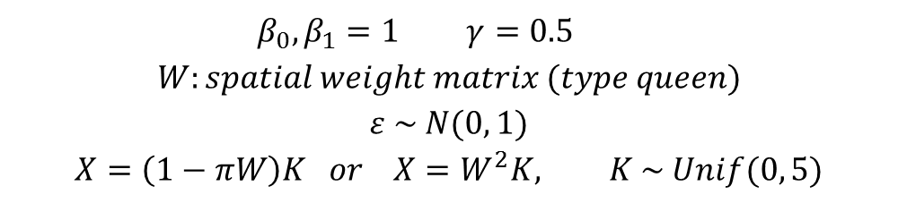
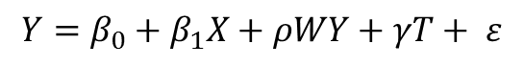
2. Methods Monte Carlo Specification
Following Reynolds (1998) and Arbia and Petrarca (2011, 2013), we approach the MAUP via simulations, focusing on the scale effect.
Specification:
Basic Spatial Unit: 1x1 cell in a regular lattice of 120x120.
Scales of analysis: 120x120, 60x60, 30x30, 24x24, 20x20, 12x12, 10x10
General specification:
Random
Spatially Dependent
$$Y=β_{0}+β_{1}X+ρWY+γT+ ε$$
Random
Clustered
Dependent on X
Random
Spatial Lag
$$β_{0}, β_{1}=1 γ=0.5$$
$$W:spatial weight matrix (type queen)$$
$$ε \sim N(0, 1)$$
$$X=\left(1−πW\right)K or X=W^{2}K, K \sim Unif(0, 5)$$

Slide 61
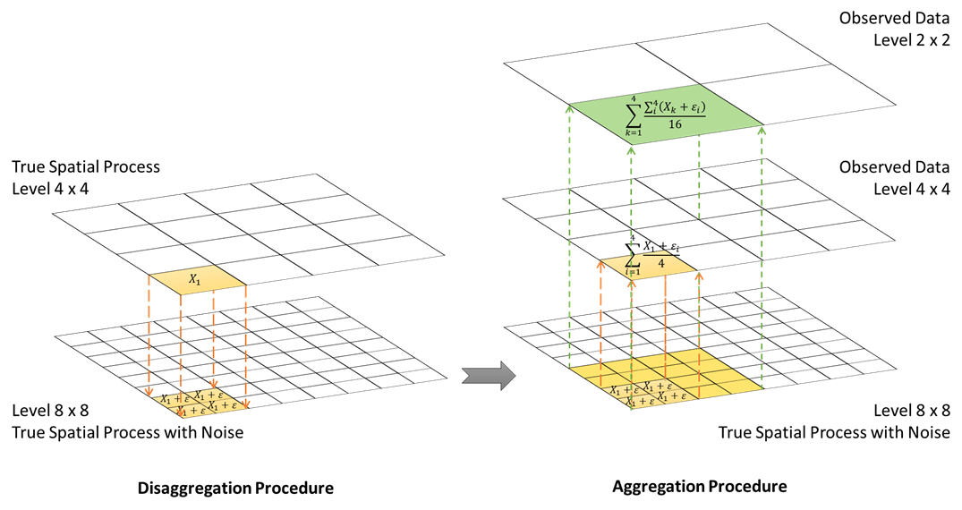
2. Methods

Slide 62
2. Methods

Slide 63
2. Methods
Scenarios

Slide 64
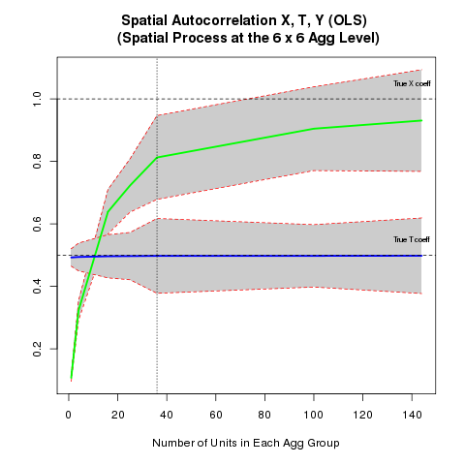
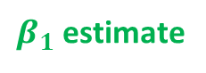
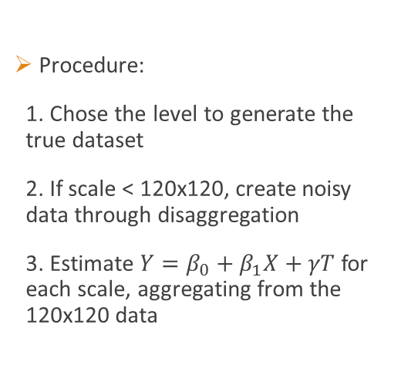

2. Methods and Results Monte Carlo Specification
Procedure:
1. Chose the level to generate the true dataset
2. If scale < 120x120, create noisy data through disaggregation
3. Estimate $Y=β_{0}+β_{1}X+γT$ for each scale, aggregating from the 120x120 data
Standard Error
TDGP Level
20x20
$β_{1}$ estimate
Scale in which the
true dataset is being
created
$γ$ estimate
# Units in Each Agg. Group
1
16
4
25
36
100
144
120
X
120
30
X
30
24
X
24
20
X
20
12
X
12
10
X
10
Data Dimension

Slide 65
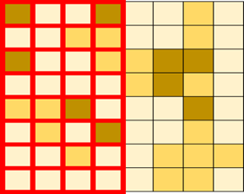
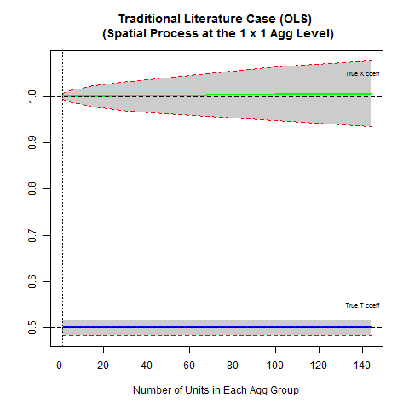
3. Results Lesson 1: Not always a problem
Y random, X random, T clustered
Effects:
Aggregation reduces data variability and the number of observations → efficiency loss
Unbiased estimates
Mitigation:
Aggregation procedure that maximizes within-group variability with respect to between-group variability
TDGP Level
120x120

Slide 66
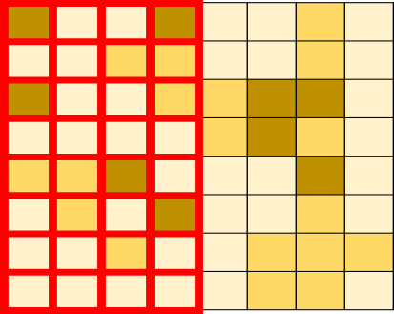
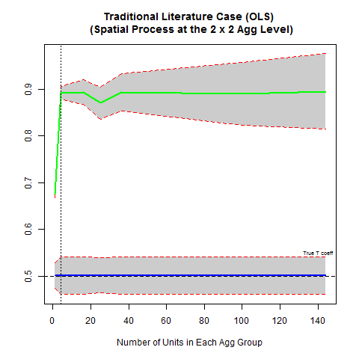
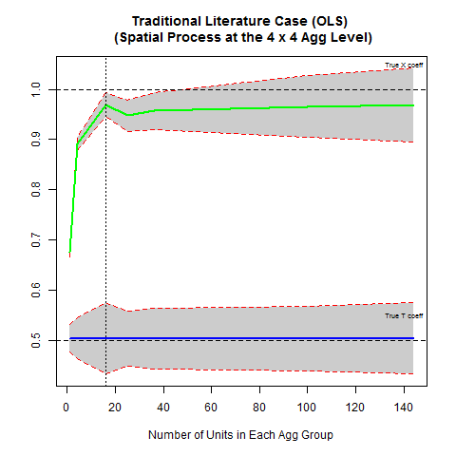
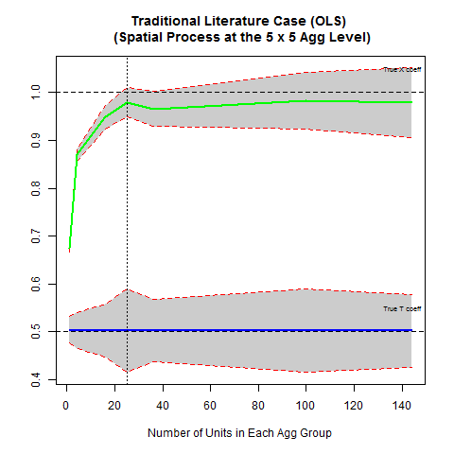
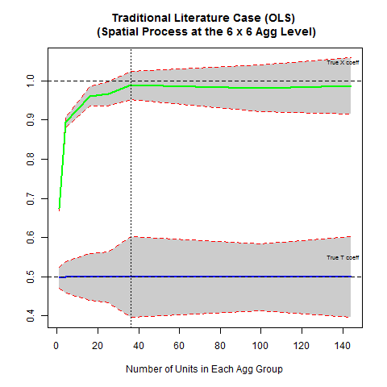
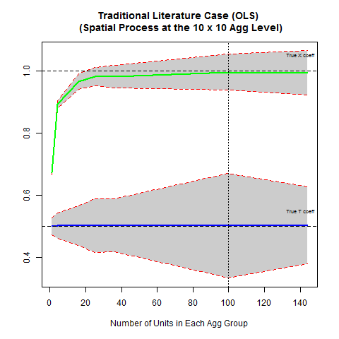
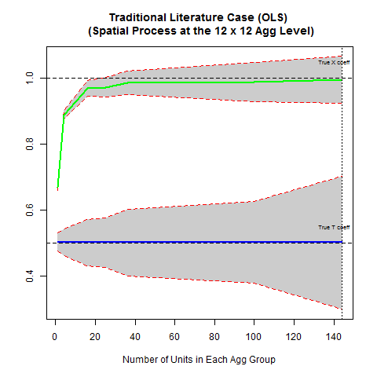
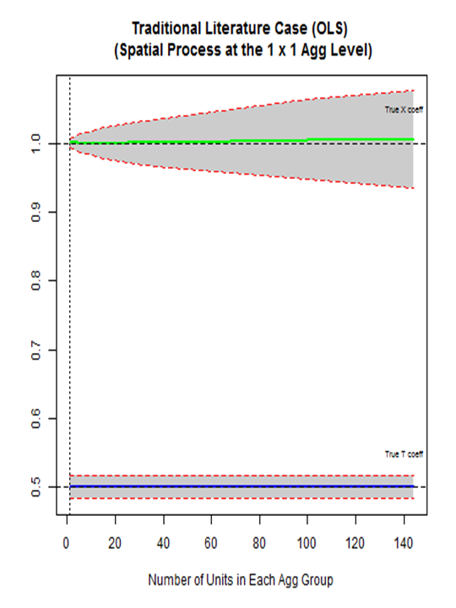
3. Results Lesson 2: Smaller is not always better
Y random, X random, T clustered
Effects:
Efficiency loss (previous result)
Disaggregation induces error in variables → bias
Mitigation:
Aggregation smooth away some of the noise reducing the bias
TDGP Level
120x120

Slide 67
3. Results Lesson 2: Smaller is not always better
Y random, X random, T clustered
Effects:
Efficiency loss (previous result)
Disaggregation induces error in variables → bias
Mitigation:
Aggregation smooth away some of the noise reducing the bias
TDGP Level
10x10
12x12
20x20
24x24
30x30
60x60
*Death by animation

Slide 68
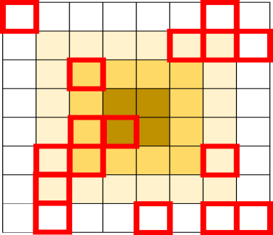
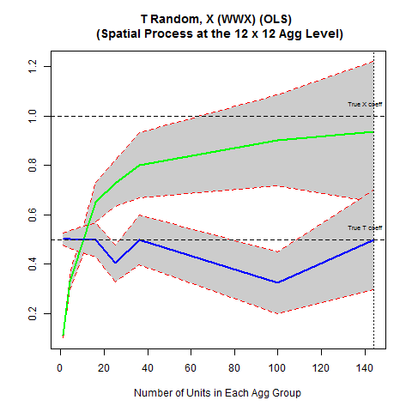
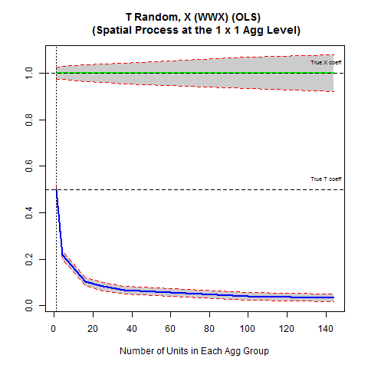
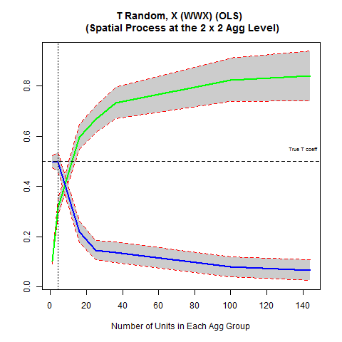
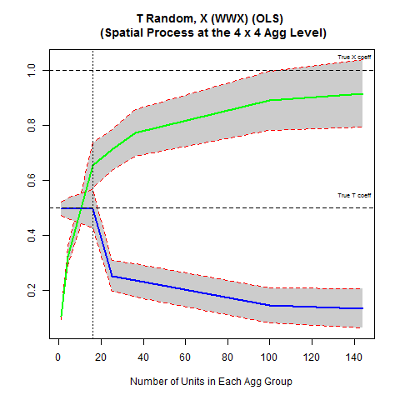
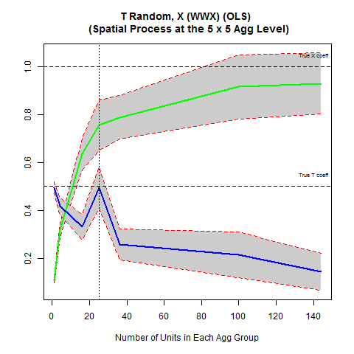
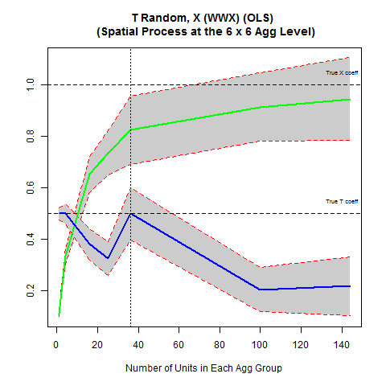
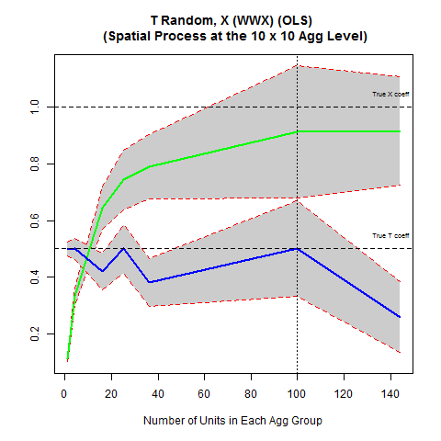
3. Results Lesson 3: Bigger is not always better
Y random, X spatially autocorrelated, T random
Effects:
Efficiency loss + bias (previous result)
Aggregation introduces error in variables in T: changes its distribution → bias towards zero (lose explanatory power)
Mitigation:
Continuous aggregation of binary variables
TDGP Level
10x10
12x12
20x20
24x24
30x30
60x60
120x120
Notes:
Two things – issues with T; spatial correlation is making things worse in X. Errors in variables can get smoothed away with aggregation if it is truly random. But if the noise is not random and the

Slide 69
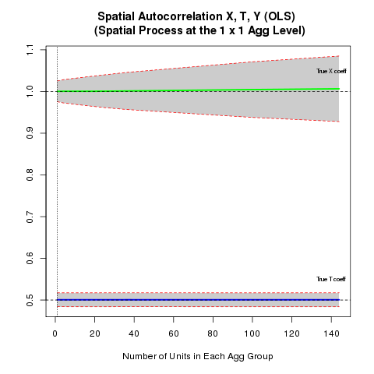
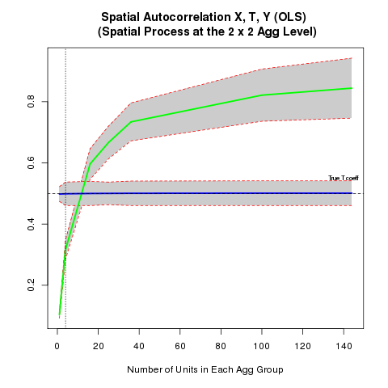
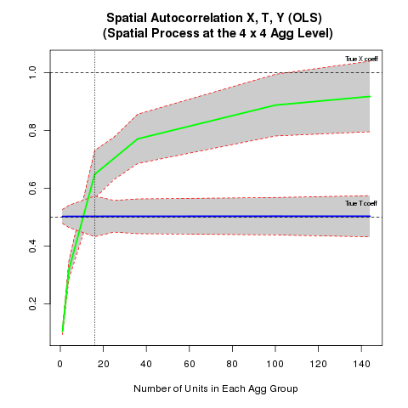
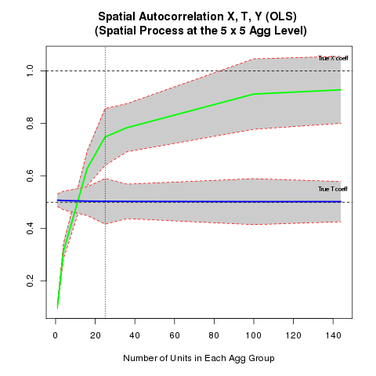
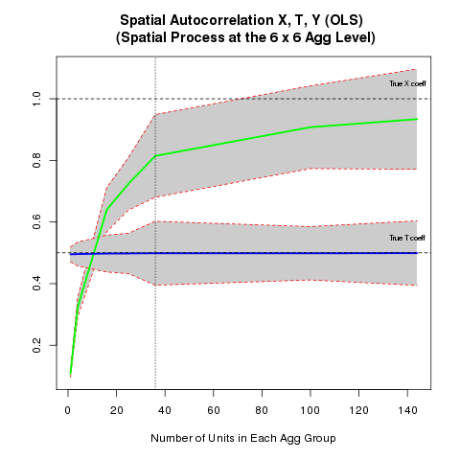
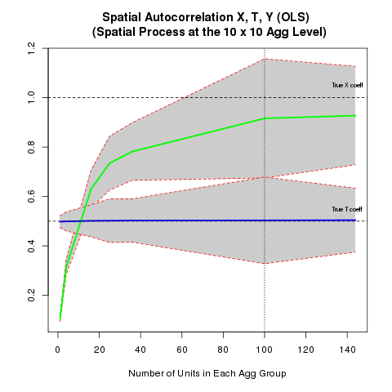
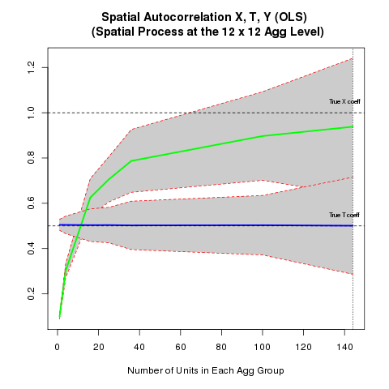
3. Methods and Results Case 3: Spatial Process on X
Y random, X spatially autocorrelated, T contiguous
Effects:
Efficiency loss + bias (previous result)
Disaggregation induces error in variables → bias
Mitigation:
Aggregation smooth away some of the noise reducing the bias
TDGP Level
10x10
12x12
20x20
24x24
30x30
Intensified as the true spatial process in X also gets noisy
60x60
120x120
# Units in Each Agg. Group
1
16
4
30
X
30
25
36
100
144
120
X
120
Depending on how close it follows the underlying spatial process of the data
Data Dimension
60
X
60
24
X
24
20
X
20
12
X
12
10
X
10
Notes:
Case 3: (X) berry location is NOT spatially random, but follows some unknown positive spatial distribution

Slide 70
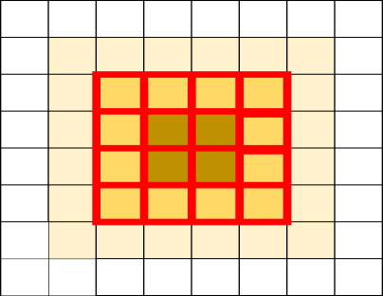
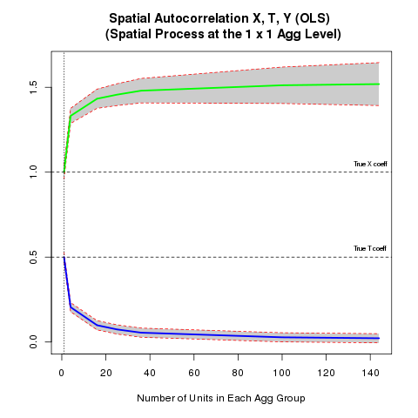
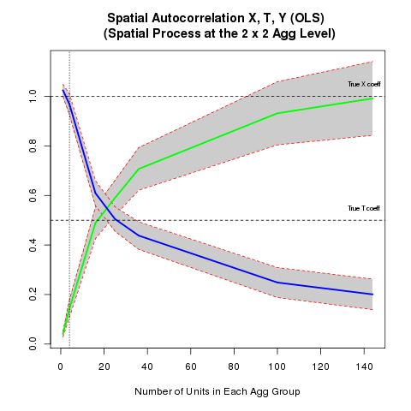
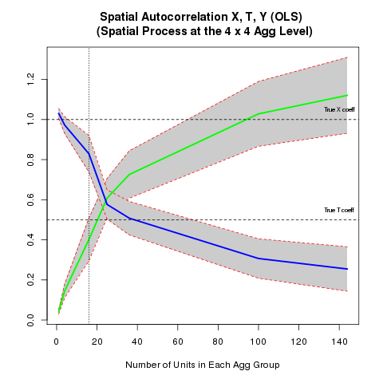
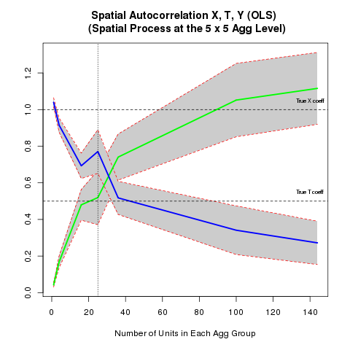
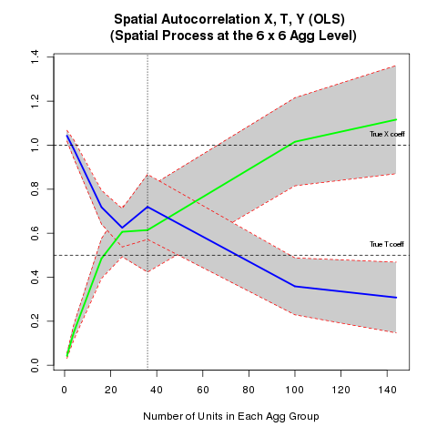
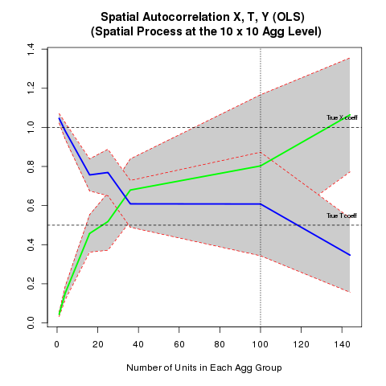
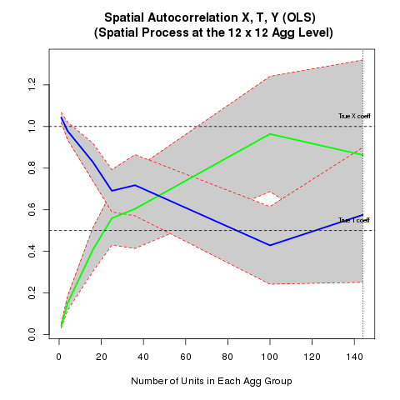
3. Results Lesson 4: Can overestimate (even at ‘right’ scale)
Y random, X spatially autocorrelated, T dependent on X
Effects:
Efficiency loss + bias (previous result)
OLS compensates loss in explanatory power: more “precise” variables tend to be overestimated and less precise underestimated → bias
TDGP Level
10x10
12x12
20x20
24x24
30x30
60x60
Depends on the degree of correlation and precision gap
120x120
Notes:
Not just always an underestimate

Slide 71








3. Results Lesson 4: Spatial processes make things worse
Y spatially lagged, X spatially autocorrelated, T dependent on X
Effects:
Efficiency loss + bias (previous result)
Omitted variable issue → bias
Mitigation:
Explicitly model the spatial process (SAR)
TDGP Level
10x10
12x12
20x20
24x24
30x30
60x60
Intensified by the degree of spatial autocorrelation (as expected)
120x120

Slide 72

(1) No Noise
(2) Noisy Dataset
(3) Spatial Process
Y random, X random, T contiguous
Y random, X random, T contiguous
Y random, X s.a., T contiguous
(4) Binary Aggregation
(5) Covariate Correlation
(6) Spatial Lag
Y random, X s.a., T random
Y random, X s.a., T = f(X)
Y s.a., X s.a., T = f(X)

Slide 73

T is contiguous
T is random
T is correlated with X

Slide 74

X is random
X is spatially lagged

Slide 75
4. Other statistical methods?
Spatial two-stage least squares
Difference-in-differences (BACI)
Matching
None solves the problem

Slide 76

OLS (red), STSLS (green), DID (blue)

Slide 77
5. Best Practices
Don’t ignore the potential bias in the estimates
Try multiple scales
Don’t use discrete measures when you don’t need to
Check correlations
Check for spatial processes
Think about spatial scale of y
Admittedly, not always clear

Slide 78
Leakage and Heterogeneity

Slide 79

Leakage and Heterogeneity e.g. Protected Areas in Indonesia
Notes:
Spatial heterogeneity and (behavioural) leakage
Have pre (2000) and post (2010)

Slide 80
Direct Effect

Slide 81
Leakage

Slide 82

(A few) Frontiers
Weights matrices
Non-spatial
endogenous
Non (semi) parametric estimators
Spatial x temporal
MAUP (Modifiable Areal Unit Problem)
Application to social networks and peer effects
Policy evaluation where policy changes the spatial relation

Slide 83

Space time continuum*
Region | a | b | c | d | e | f | g | h | i | j | k | l | m | n
T
T+1
T+2
T+3
T+4
T+5
T+6
T+7
T+8
T+9
T+10
*And why spatial ‘metrics isn’t just time series

Slide 84
Space time continuum*
Region | a | b | c | d | e | f | g | h | i | j | k | l | m | n
T
T+1
T+2
T+3
T+4
T+5
T+6
T+7
T+8
T+9
T+10

Slide 85
Space time continuum*
Region | a | b | c | d | e | f | g | h | i | j | k | l | m | n
T
T+1
T+2
T+3
T+4
T+5
T+6
T+7
T+8
T+9
T+10
*And why spatial ‘metrics isn’t just time series

Slide 86
Space time continuum*
Region | a | b | c | d | e | f | g | h | i | j | k | l | m | n
T
T+1
T+2
T+3
T+4
T+5
T+6
T+7
T+8
T+9
T+10

Slide 87
Space time continuum*
Region | a | b | c | d | e | f | g | h | i | j | k | l | m | n
T
T+1
T+2
T+3
T+4
T+5
T+6
T+7
T+8
T+9
T+10

Slide 88
Space time continuum*
Region | a | b | c | d | e | f | g | h | i | j | k | l | m | n
T
T+1
T+2
T+3
T+4
T+5
T+6
T+7
T+8
T+9
T+10

Slide 89
Space time continuum*
Region | a | b | c | d | e | f | g | h | i | j | k | l | m | n
T
T+1
T+2
T+3
T+4
T+5
T+6
T+7
T+8
T+9
T+10

Slide 90
Space time continuum*
Region | a | b | c | d | e | f | g | h | i | j | k | l | m | n
T
T+1
T+2
T+3
T+4
T+5
T+6
T+7
T+8
T+9
T+10

Slide 91
Spatial panel
Region | a | b | c | d | e | f | g | h | i | j | k | l | m | n
T
T+1
T+2
T+3
T+4
T+5
T+6
T+7
T+8
T+9
T+10

Slide 92
An embarrassingly incomplete sampling of references
Anselin, Luc. “Under the Hood: Issues in the Specification and Interpretation of Spatial Regression Models” Agricultural Economics.
Anselin, Florax and Rey, eds. 2004. Advances in Spatial Econometrics: Methodology, Tools and Applications. Springer: New York
Anselin. 1988. Spatial Econometrics: Methods and Models Kluwer: Boston.
Bramoulle, Djebbari and Fortin. 2009. “Identification of peer effects through social networks” Journal of Econometrics
Anselin, L. and Lozano-Garcia. 2007. “Errors in variables and spatial effects in hedonic house price models of ambient air quality” Empirical Economics (spatial HAC and kriging)
Baltagi, B. Seuck Heun Song and Won Koh. 2003. “Testing panel data regression models with spatial error correlation” Journal of Econometrics 117: 123-150. (spatial panel)
Baltagi, B.H., Egger, P., Pfaffermayr, M., 2007. “Estimating models of complex FDI: Are there third-country effects?”. Journal of Econometrics, 140: 260-281 (spatial panel)
Brueckner, Jan and Luz Saavedra. 2001. “Do Local Governments Engage in Strategic Property-Tax Competition?” National Tax Journal. (spatial lag)
Conley, J. 1999. “GMM Estimation with Cross Sectional Dependence” Journal of Econometrics (92):1-45.
Conley standard errors…
Flemming, Mark M. 2004. “Techniques for Estimating Spatially Dependent Discrete Choice Models” in Anselin, Florax and Rey, eds Advances in Spatial Econometrics. Springer: New York. (discrete choice models)
Kapoor, Mudit, Harry H. Kelejian and Ingmar R. Prucha. 2007. “Panel data models with spatially correlated error components” Journal of Econometrics 140: 97-130. (Spatial panel)
Kelejian, Harry H. and Ingmar R. Prucha. 2007. “HAC estimation in a spatial framework” Journal of Econometrics 140: 131-154. (Spatial HAC)
LeSge and Pace. 2009. Introduction to Spatial Econometrics. CRC Press: New York.
McMillen, Daniel P. 1992. “Probit with Spatial Autocorrelation” Journal of Regional Science 32(3): 335-348. (Spatial Probit)
McMillen and …
Sain, Stephan R.; Cressie, Noel. 2007. “A Spatial Model for Multivariate Lattice Data” Journal of Econometrics, September 2007, v. 140, iss. 1, pp. 226-59

Slide 93
MAUP
Arbia, G. (1989a). Statistical Effect of Data Transformations: A Proposed General Framework. In Goodchild, M. and Gopal, S. (Eds.), The Accuracy Of Spatial Databases (249-259). Bristol: Taylor & Francis.
Arbia, G. (1989b). Spatial Data Configurations in Statistical Analysis of Regional Economic and Related Problems. Massachusetts: Kluwer Academic Publishers.
Arbia, G. and Petrarca, F. (2011). Effects of MAUP on Spatial Econometric Models. Letters in Spatial and Resource Sciences, 4:173-185.
Batty, M. and Sikdar, P. (1982). Spatial Aggregation in Gravity Models: 1. An Information-Theoretic Framework. Environment and Planning A, 14: 377-405.
Blalockel, H. (1964). Causal Inferences in Nonexperimental Research. Chapel Hill: University of North Carolina Press.
Chan KMA, Shaw MR, Cameron DR, Underwood EC, Daily GC (2006) Conservation planning for ecosystem services. PLoS Biology 4: e379.
Dark, S.J., and Bram, D. (2007) The modifiable areal unit problem (MAUP) in physical geography. Progress in Physical Geography 31(5):471-479.
Fotheringham, A. and Wong, D. (1991) The Modifiable Areal Unit Problem in Multivariate Statistical Analysis. Environment and Planning A, 23: 1025-1044.
Gehlke, C. and Biehl, K. (1934). Certain Effects of Grouping upon the Size of the Correlation Coefficient in Census Track Material. Journal of the American Statistical Association Supplement, 29: 169-170.
Gotway, C. and Young, L. (2002). Combining Incompatible Spatial Data. Journal of the American Statistical Association, 97: 632-648.
Gotway, C. and Young, L. (2004). Change of support: an inter-disciplinary challenge. In Renard, P., Demougeot-Renard, H. and Froidevaux, R. (Eds.), Geostatistics for Environmental Applications. Netherlands: Springer.
Hay, G.J., Blaschke, T., Marceau, D.J., Bouchard, A. (2003). A comparison of three image-object methods for the multiscale analysis of landscape structure. Photogrammetry & Remote Sensing. 57:327-345.
Jelinski, D. and Wu, J. (1996). The Modifiable Areal Unit Problem and Implications for Landscape Ecology. Landscape Ecology, 11(3): 129-140.
Manley, D., Flowerdew, R, and Steel, D. (2006) Scales, levels and processes: Studying spatial patterns of British census variables. Computers, Environment and Urban Systems. 30:143-160.
Openshaw, S. (1970). The Modifiable Areal Unit Problem. Norwich: Geo Books.
Openshaw, S. (1978). An Empirical Study of Some Zone-Design Criteria. Environment and Planning A, 10: 781-794.
Openshaw, S. and Taylor, P. (1979). A Million or So Correlation Coefficients: Three Experiments on the Modifiable Areal Unit Problem. In Wrigley, N. (Eds.), Statistical Applications in the Spatial Sciences (127-144). London: Pion.
Reynolds, H. (1998). The modifiable area unit problem: Empirical analysis by statistical simulation (Doctoral Dissertation). Available from ProQuest Dissertations and Theses Database. (UMI No. NQ35299)
Robinson, A. (1956). The Necessity of Weighting Values in Correlation Analysis of Areal Data. Annals of the Association of American Geographers, 46: 233-236.
Thomas, E. and Anderson, D. (1965). Additional Comments on Weighting Values in Correlation Analysis of Areal Data. Annals of the Association of American Geographers, 55: 492-505.

Slide 94
Matching
Matching and Forest Conservation
Blackman
Sánchez-Azofeifa GA, Pfaff A, Robalino JA, Boomhower JP (2007) Costa Rica’s payment for environmental services program: intention, implementation, and impact. Conservation Biology 21: 1165–1173.
Alix-Garcia…
Forest Leakage
Gaveau DLA, Epting O, Linkie M, Kumara I, Kanninen M, et al. (2009) Evaluating whether protected areas reduce tropical deforestation in Sumatra. Journal of Biogeography 36: 2165–2175.
Pfaff…

Slide 95
RDD
Aggrawal, D. 2014 AEJ

